Slide 1
Portfolio - to Oct 23
Joanne Tucker

Slide 2
Introduction
Joanne Tucker
I’m an experienced Contract Director and ex co-owner of a home healthcare medical device services company with 15 years experience in the health sector. My values have always been to keep the patient at the centre of what we do, and to operate as a long-term strategic partner to the NHS.
Following a career break to raise our children, in January 2023 I embarked on a new, but related challenge, to learn python and data analysis as I’ve always believed useful, ready data is so key to the successful delivery of healthcare and is often lacking - to the frustration of many clinicians.
The Cambridge Sparks course has completely fulfilled my Data Analyst training:
-the use of python and pandas to clean data intelligently for analysis
- interrogation of large datasets to find insights using python and pandas
- the use of seaborn, matplotlib, bokeh and pandas to visualise data and trends
- the art of communicating the insights identified
I am excited to layer this new data analysis knowledge with my health industry experience to play a role in the ongoing digital transformation of the NHS, to help realise future advances in medicine and to improve patient outcomes through health informatics.

Slide 3
How does data add value to organisations?
Joanne Tucker
I am particularly drawn to the potential for data analysis and health informatics to enable clinical and social care insights that can directly benefit patient health outcomes:
through earlier diagnosis;
and wide-spread home patient monitoring to avoid hospitalisation.
I believe the future of healthcare is in treating the whole patient, treating to prevent conditions, more personalised treatment and the blurring of lines between home care and care.
The foundation to this is enabling shared data that can be systematically analysed.

Slide 4
UK Road Network Use
Joanne Tucker

Slide 5
British Road Network Analsysis
Joanne Tucker
Situation – Required to analyse a pre cleaned .csv dataset from the UK Department of Transport on vehicle use and road network data covering 1993 - 2018. Working independently.
Objectives:
- 1) Identify the change in road use by 3 vehicle types over the period
- 2) Identify, by region, the use of greener vehicle types in a 2018 snapshot
- 3) Identify the change in road use by motor vehicles, by region, over period
- 4) To achieve all of the above without external support using pandas and bokeh
Action – I used a combination of pandas and python programming methods: groupby; sorting values; creating an index to show changes in variables against a base (using .iloc[0]). I then then created visualisations using pandas_bokeh methods and clearly labelled them for clear presentation.
Key Results from Independent Analysis:
Cycle use has risen on average 5.3% per year across the UK in the period.
In 2018 the South East region had the most miles covered by pedal cycle and buses combined, 10.2% more than the next closest (London)
But London saw a 7% decrease in road use over the period, while the South East increased by 21.9%

Slide 6
British Road Network Analsysis
Joanne Tucker
Result
These findings could help to better prioritise regional competition for: funding for cycle routes, funding for road maintenance, funding for the rail network development as an alternative to roads as well as priorisation for targeting public awareness campaigns for promoting cycling / public transport / cycle safety campaigns.
Importantly it could lead to further analysis on why the difference in cycle uptake? Topology, distance between typical work/leisure/retail commutes, income and cost of living data by region by year.
Reflection – Recognise that sometimes when you think you’ve reached the final visualisation, that it is often the start of things, and embrace the sometimes ever diverging nature of data analysis to uncover answers.

Slide 7
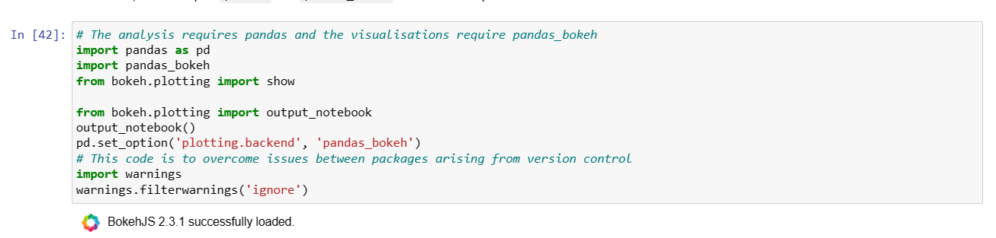
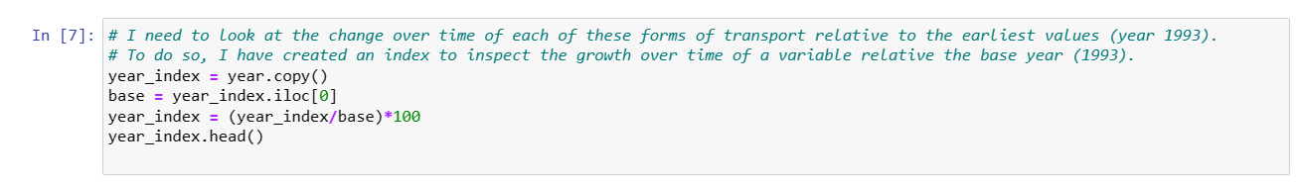
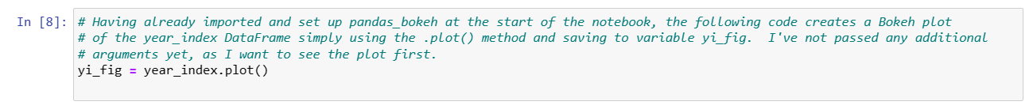
UK Road Network – 1) Identify Change in Road Use by 3 Vehicle Type over Period
Joanne Tucker

Slide 8
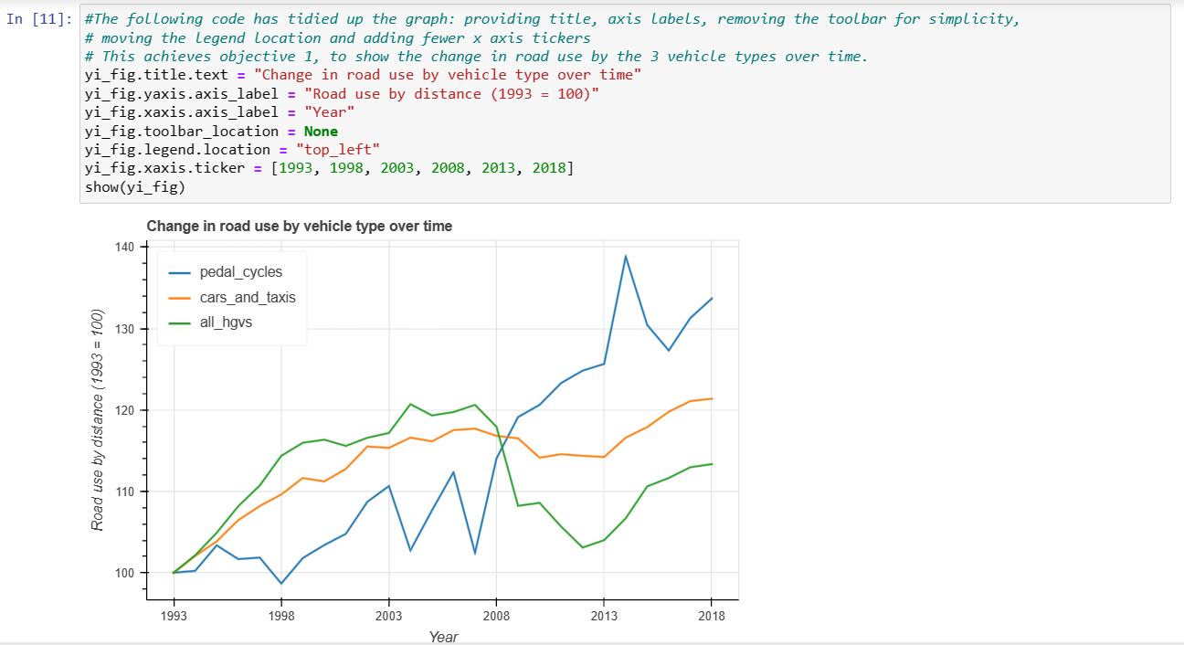
UK Road Network Use – 1) Identify Change in Road Use by 3 Vehicle Type overs Period
Joanne Tucker
Pedal cycles grew in use in the UK on average by 5.3% pa in the 25 years between 1993 and 2018.
At their peak, their use grew by 36% between 2007 and 2014.
I now wonder if this was cost driven (financial crisis of 2007/8) or climate change driven.

Slide 9
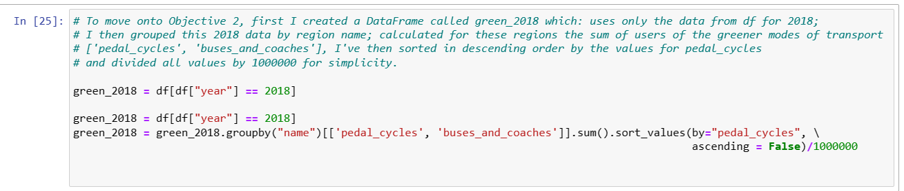
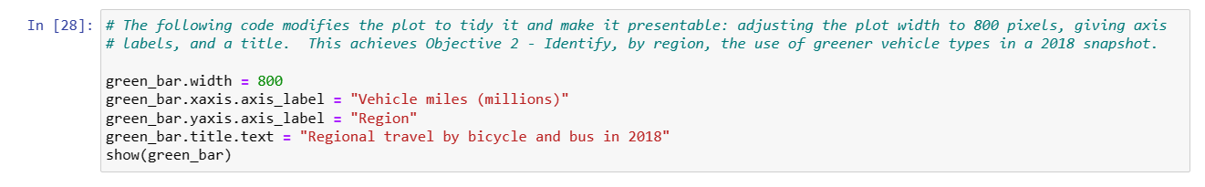
UK Road Network Use – 2) Identify, by region, the use of greener vehicle types in a 2018 snapshot
Joanne Tucker

Slide 10
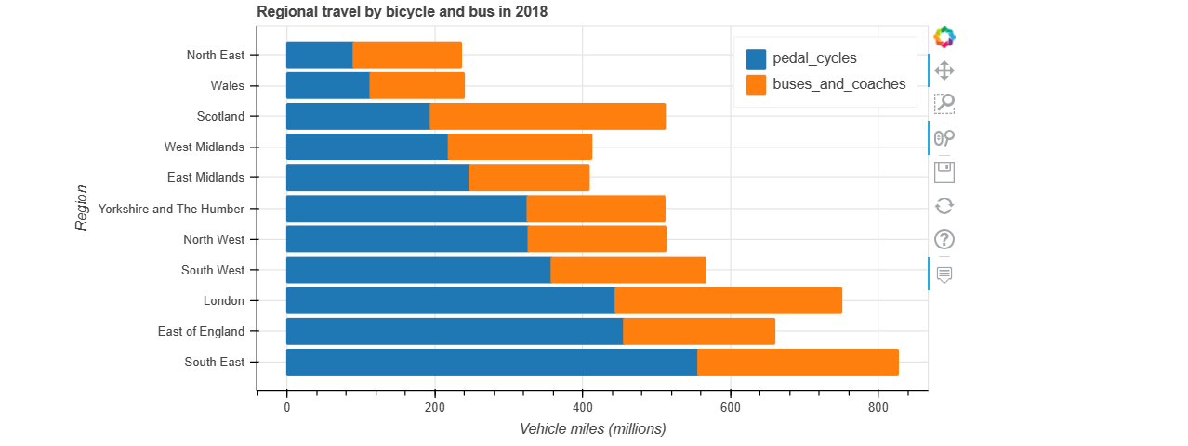
UK Road Network Use – 2) Identify, by region, the use of greener vehicle types in a 2018 snapshot
Joanne Tucker
The South-East has the greatest number of vehicle miles undertaken by pedal cycle and buses combined in 2018…
10.2% more than London the next closest, and
351% more than the North-East - the lowest region
(I now want to be able to break down the purpose for the pedal cycle journeys, were they 100% for transport reasons (and so directly comparable) or were some for health reasons - and so arguably not)

Slide 11
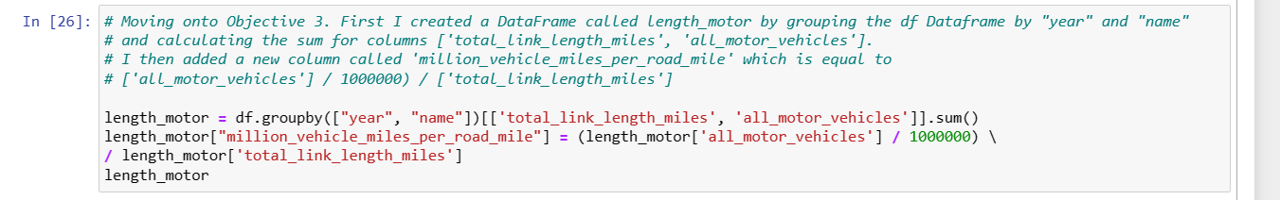
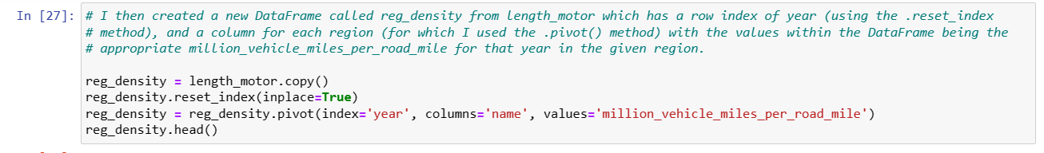
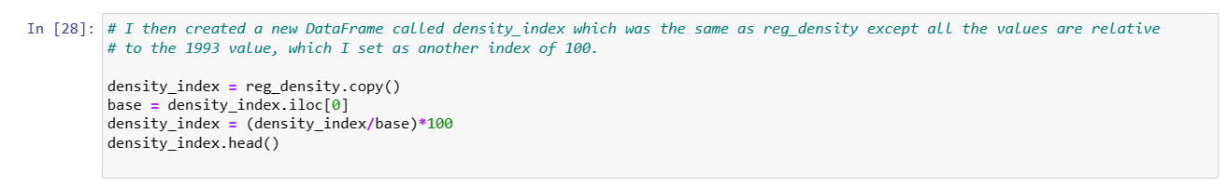
UK Road Network Use - 3) Identify the change in road use by motor vehicles, by region, over period
Joanne Tucker

Slide 12
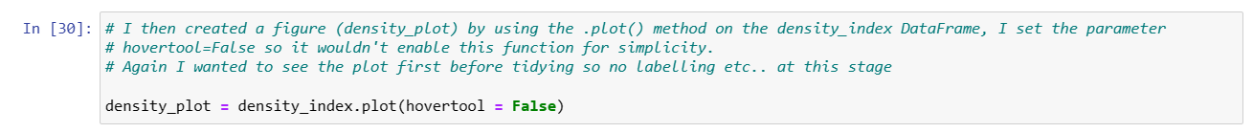
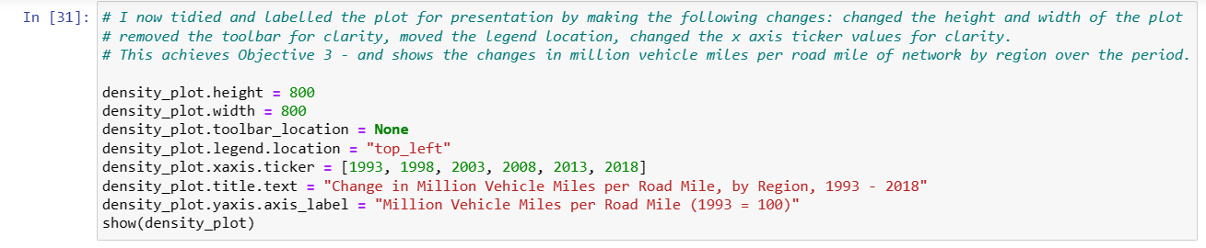
UK Road Network Use
Joanne Tucker

Slide 13
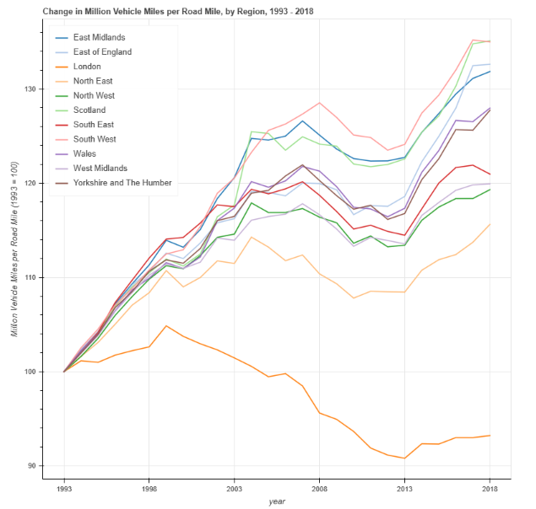
UK Road Network Use
Joanne Tucker
London 7% decrease in road use over period
While South-East had a 21.9% increase and
North-East had the second lowest increase at only 15.6%
"country_additional_1

Slide 14
Chocolate Rating
Joanne Tucker

Slide 15
Chocolate Rating Analysis
Joanne Tucker
Situation – Required to analyse a pre-cleaned .csv dataset containing the ratings of chocolate bars produced by UK and Swiss companies. Ratings : 1-5 (5 = best). Working independently.
Objectives:
- 1) To compare ratings nationally, presenting the findings in an appropriate visual manner
- 2) To identify any outliers in the UK
- 3) To achieve the above without external support using python, pandas and seaborn
Action – Following some exploratory analysis, I created a seaborn box and whisker plot of the dataset, labelling it appropriately. I then created a function in python to identify outliers if certain criteria relating to the InterQuartile Range were met, and asked python to return any outliers found as a list. I then applied this function to the UK filtered dataset.
Key Results from Independent Analysis:
Swiss chocolate is indeed better than the UK’s with a mean of 3.4 and median of 3.5 (10.7% higher and 16.7% higher than the UK respectively).
The UK has two very high outliers with ratings of 5.0 and 4.75, and a very low outlier, rating of 1.5.

Slide 16
Chocolate Rating Analsysis
Joanne Tucker
Result
These findings could help the UK market to improve their quality overall, if this is deemed a strategic objective. The low lying outlier could implement sourcing, production and marketing changes to mirror the higher outliers in the UK market and therefore help to improve their own and the market’s ratings in the future.
If improvements were not saught by the UK companies, these findings help with marketing strategies to create the optimum targeting and positioning campaigns for the UK compaies to ensure sales are maximised.
Reflection – Using python code to apply functions can be really useful to quickly and easily pull out data insights from datasets.

Slide 17
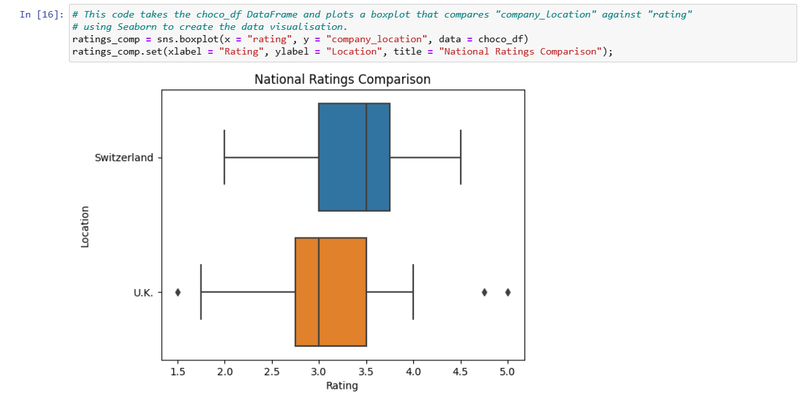
Chocolate Rating Analysis - 1) Compare how UK Ratings fare vs Swiss Ratings
Joanne Tucker
The mean rating for Switzerland, at 3.4, was 10.7% higher than the UK’s.
The median rating for Switzerland, at 3.5, was 16.7% higher than the UK’s.
The UK has outlying data

Slide 18
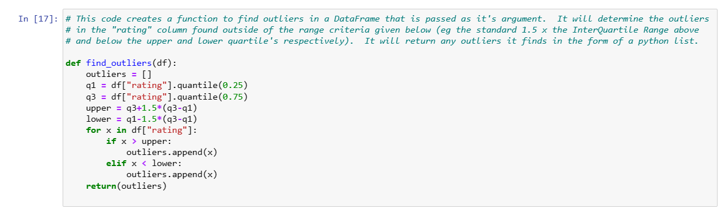
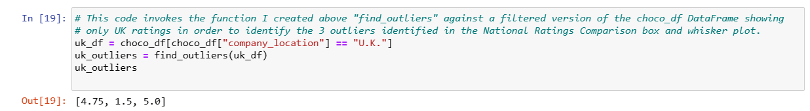
Chocolate Rating Analysis - 2) Identify and outliers from the National Ratings Comparison
Joanne Tucker
We now know that the UK has two very high outliers with ratings of 5.0 and 4.75, and one very low outlier at a rating of 1.5.

Slide 19
Sleep Analysis –
End of Course Research Project
Joanne Tucker

Slide 20
Sleep Analysis
Joanne Tucker
Situation – Find and analyse a dataset of your own choice. Found a small but interesting dataset on Kaggle regarding Sleep and Lifestyle. Worked independently.
Objectives:
- 1) To examine which Occupations enjoy the best sleep
- 2) To identify if there any correlations between lifestyle and sleep habits
Action
– I had to undertake a lot of data cleaning and preparation to allow full analysis of the data set. Some of this included creating python functions to apply to data Series to create new variable categories that were more easily analysed (eg blood pressure ranges and numeric values for bmi categories).
- A heatmap was produced in Seaborn to more easily identify correlations.
- Sleep Duration and Quality by Occupation analysis was completed using the .groupby() method
- A visualisation of Sleep Disorders by Occupation was produced
- Analysis of correlations between Stress Levels and Sleep Duration and Quality was undertaken

Slide 21
Sleep Analsysis
Joanne Tucker
Key Results from Independent Analysis:
Engineers enjoy the best Sleep Quality and Duration. Sales Reps and Scientists have the worst sleep duration of the occupations sampled with 16% and 14% less respectively than that of Engineers and 52% and 40% less respectively than that of Engineers again. Strangely diagnosis of Sleep Disorders is low in Sales Reps, Scientists and Engineers. Nursing is the most diagnosed occupation.
Stress Level has a very strong correlation to both Sleep Duration and Quality of Sleep.
Insomniacs experience a greater negative correlation between Stress Level and Sleep Duration
Patients diagnosed with Insomnia experience poorer Quality of Sleep than Sleep Apnoea Patients, but sleep apnoea has a greater negative correlation between Stress Level and Quality of Sleep
Result
These findings could help the NHS target occupations for sleep disorder diagnosis and improve patient outcomes. Sleep Apnoea has a proven link with road traffic accidents, so pulling in more Sales Reps for diganosis and management could save lives.
Although correlation isn’t always causation, these findings further support the fact that stress management is a crucial step to improving sleep.
Reflection – Using heatmaps early on can really help guide analysis.

Slide 22
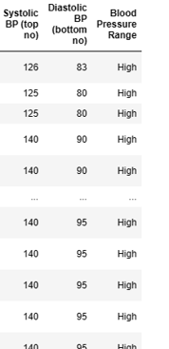
Sleep Analysis – Data Cleaning and Preparation
Joanne Tucker
- Changed gender from M / F response to Male Gender? 1 for yes, 0 for no (to enable inclusion of gender in heatmap correlation exercise)
- Detailed preparation of Blood Pressure data, firstly changed into Systolic and Diastolic columns then I wrote a function to convert readings into standard Blood Pressure range Low, Normal, Elevated, High, Hypertensive and applied it using the numpy .vectorize() method. See output right.
- Mapped a python dictionary to a new column BMI category to enable inclusion of numerical BMI data in heatmap correlation exercise
- Introduced several new columns to numerate the Sleep Disorder column to enable inclusion in the heatmap correlation exercise

Slide 23
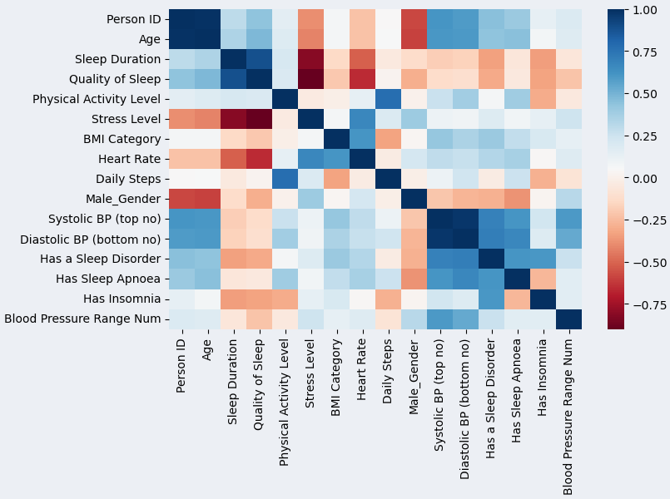
Sleep Analysis – Heatmap showing correlation between variables
Joanne Tucker
Heatmap of correlation matrix
High positive correlations between:
- Sleep duration & sleep quality & age
High negative correlations between:
- Sleep duration / quality & stress level
- Stress level & insomnia

Slide 24
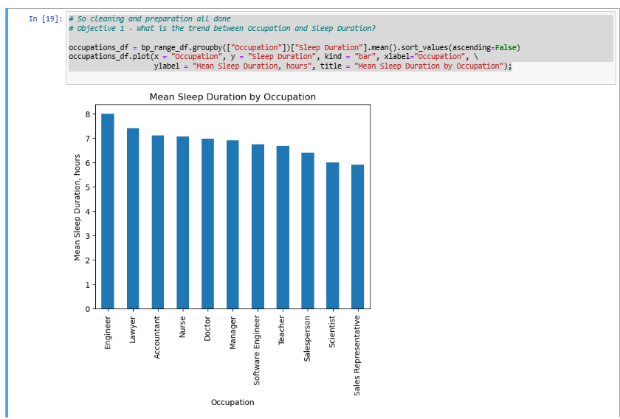
Sleep Analysis – 1) To analyse which occupations enjoy the best sleep - Sleep Duration
Joanne Tucker
Sales Representatives and Scientists have the worst sleep duration of the occupations sampled with 16% and 14% less respectively than that of Engineers, who enjoy the best sleep duration.
NB the variability is not large in the sample, with a standard deviation of only 0.5

Slide 25
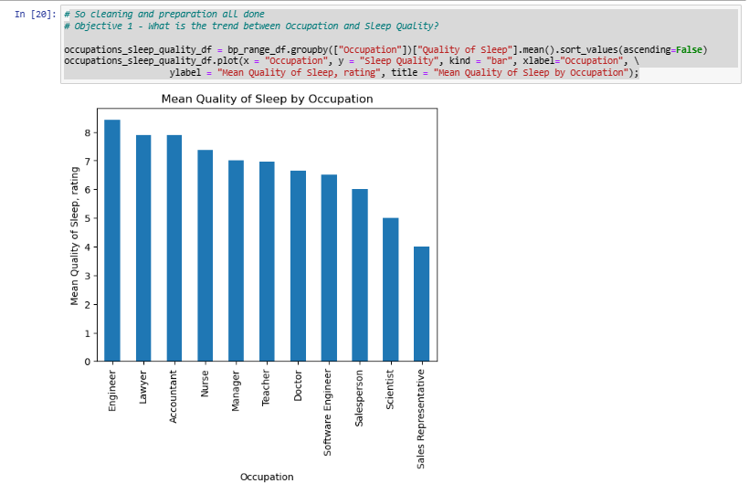
Sleep Analysis – 1) To analyse which occupations enjoy the best sleep - Quality of Sleep
Joanne Tucker
Sales Representatives and Scientists also have the worst quality of sleep of the occupations sampled with 52% and 40% less respectively than that of Engineers, who enjoy the best rated quality of sleep.
The variability is greater in this plot, with standard deviation of 1.3

Slide 26
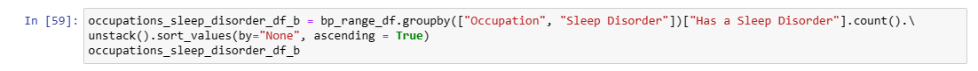
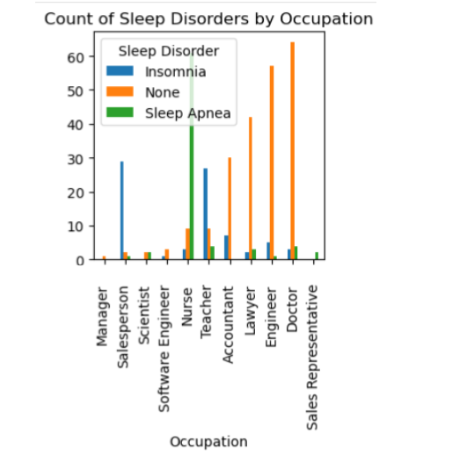
Sleep Analysis 1) To analyse which occupations enjoy the best sleep - Sleep Disorder
Joanne Tucker
The largest occupation with diagnosis of a sleep disorder is Nurse, incongruous as they enjoy relatively good sleep duration and quality of sleep!
Perhaps due to awareness of conditions and likelihood of seeking a diagnosis.
The dataset suggests Engineers enjoy the best sleep from our sample, with Sales Reps the worst and Nurses the most diagnosed.

Slide 27
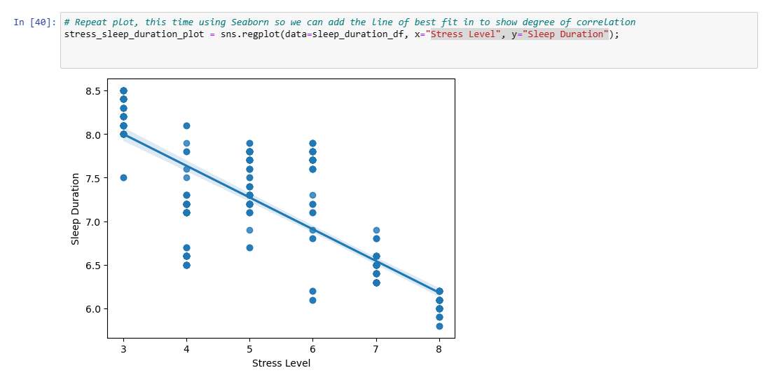
Sleep Analysis – 2) To identify any correlations between Sleep and Lifestyle - Stress and Sleep Duration
Joanne Tucker
Stress Level has a negative correlation to Sleep Duration.
The more stressed you are, the less you sleep.

Slide 28
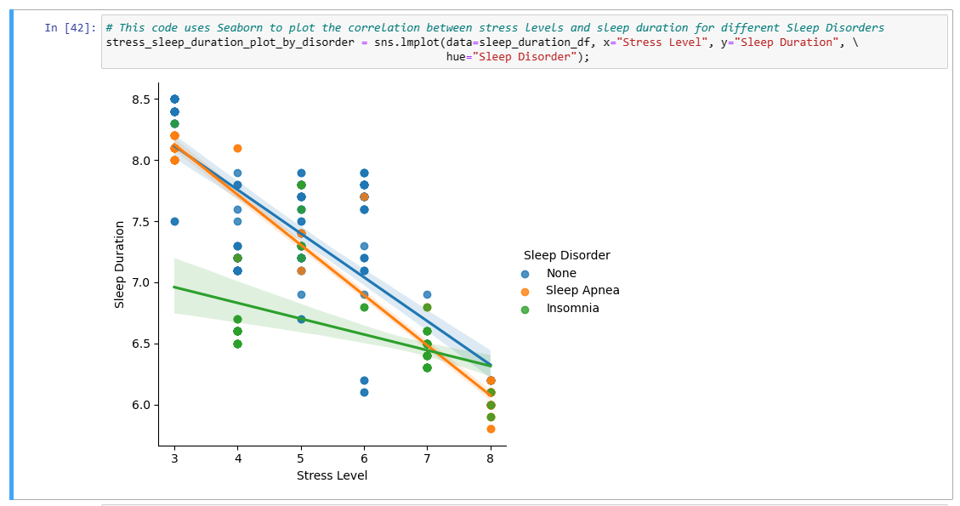
Sleep Analysis – 2) To identify any correlations between Sleep and Lifestyle - Stress and Sleep Duration by Disorder
Joanne Tucker
Patients diagnosed with Insomnia experience a greater negative correlation between Stress and Sleep Duration

Slide 29
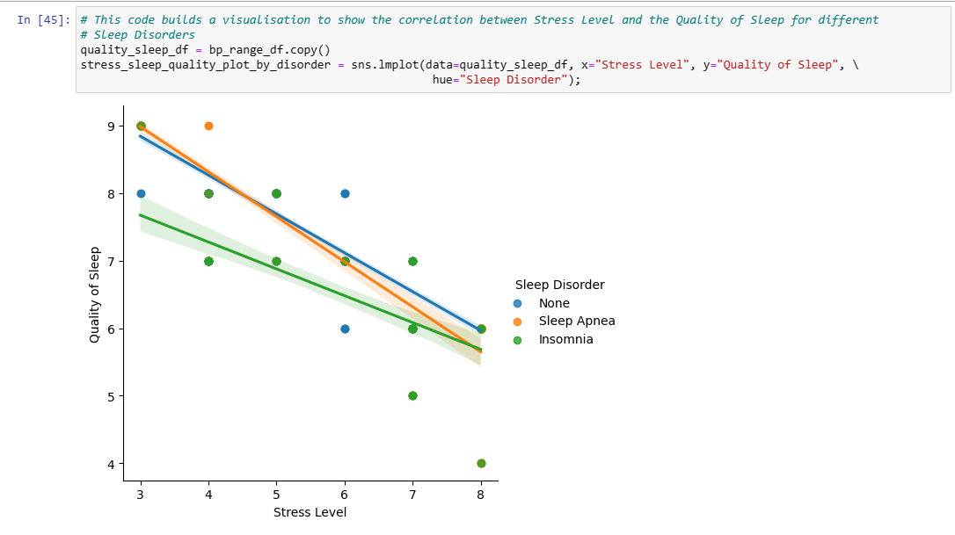
Sleep Analysis – 2) To identify any correlations between Sleep and Lifestyle - Stress and Quality of Sleep by Disorder
Joanne Tucker
Patients diagnosed with Insomnia experience poorer Quality of Sleep than Sleep Apnoea Patients
But sleep apnoea has a greater negative correlation between Stress Level and Quality of Sleep

Slide 30
Appendix to Portfolio
Joanne Tucker
Please see separate word document for full code
for each project

